Slide 1

What Happened in Vegas, Left Vegas Cool Stuff from Def Con 31
Andrew Kenneally
andrewk4@pm.me
linkedin.com/in/andrew-kenneally/
github.com/andrewk10

Slide 2
Some Caveats and Content Warnings
I won’t go into heavy technical detail on all attacks.
Some of these guys are experts in their field and to condense 45 minute exploit talks into a 1 - 2 minute slide is tough. For more deeper dives see the Def Con 31 media server, all slides and demos can be found there, I only cover what I actually went to see and what I found worth sharing; https://media.defcon.org/DEF%20CON%2031/
Content Warning: Slides contain references to Human Trafficking and Abortion.

Slide 3
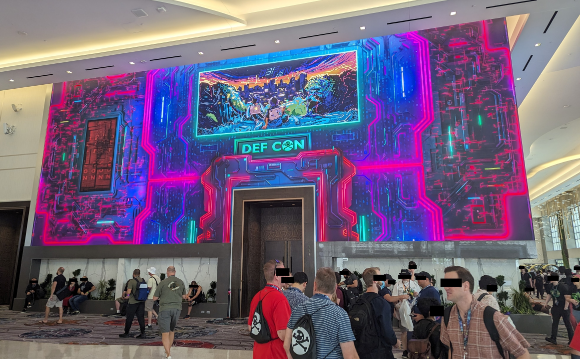
What is Def Con?
DEF CON is one of the oldest continuously running hacker conventions around, and also one of the largest.
Generally held in the last week of July or first week of August in Las Vegas. DEF CON 31 was held on August 10th through August 13th, 2023.

Slide 4
Topics, Demos and Talks

Slide 5

Boston Infinite Money Glitch Hacking Transit Cards without Ending Up In Handcuffs
Matthew Harris
Medford Vocational Technical High School Student
Zachary Bertocchi
Hacker
Scott Campbell
Hacker
Noah Gibson
Hacker https://youtu.be/1JT_lTfK69Q

Slide 6
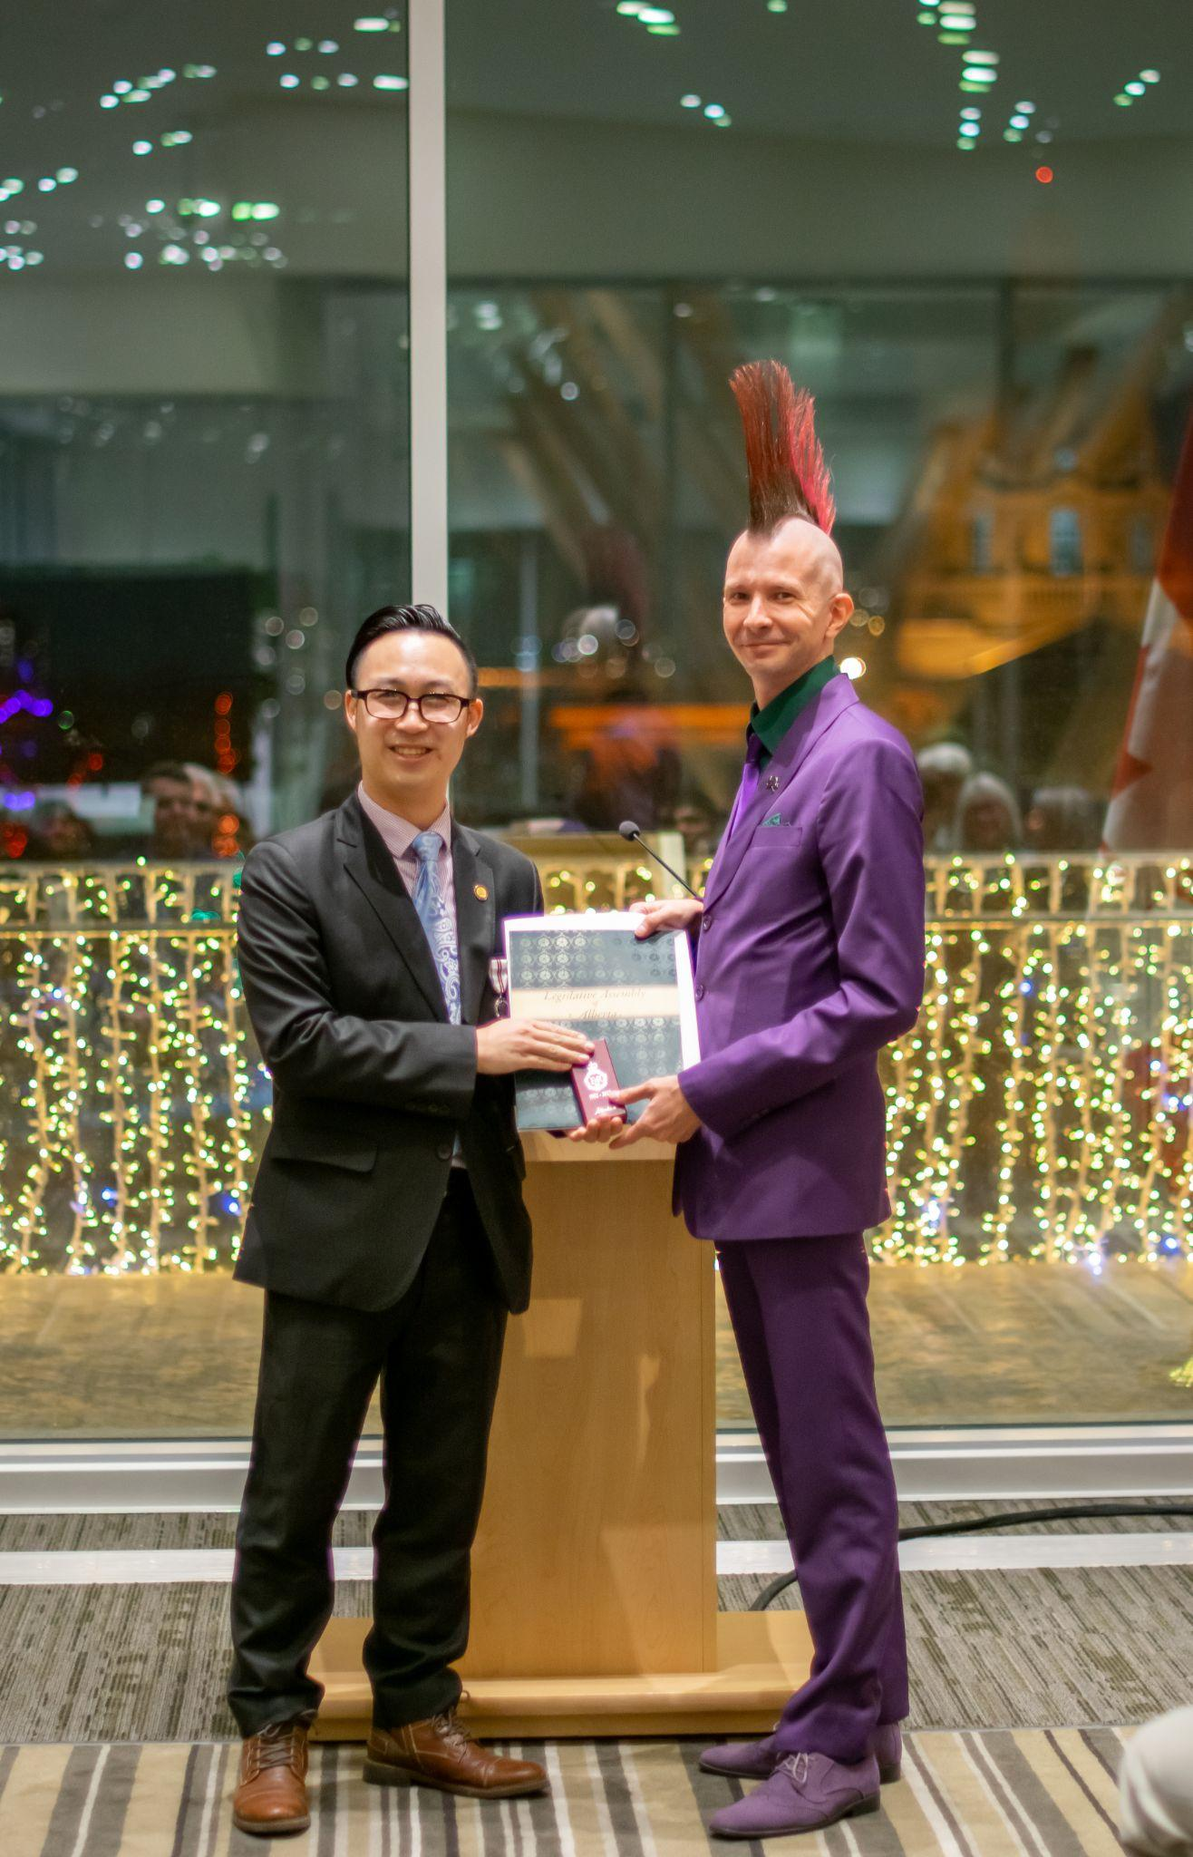

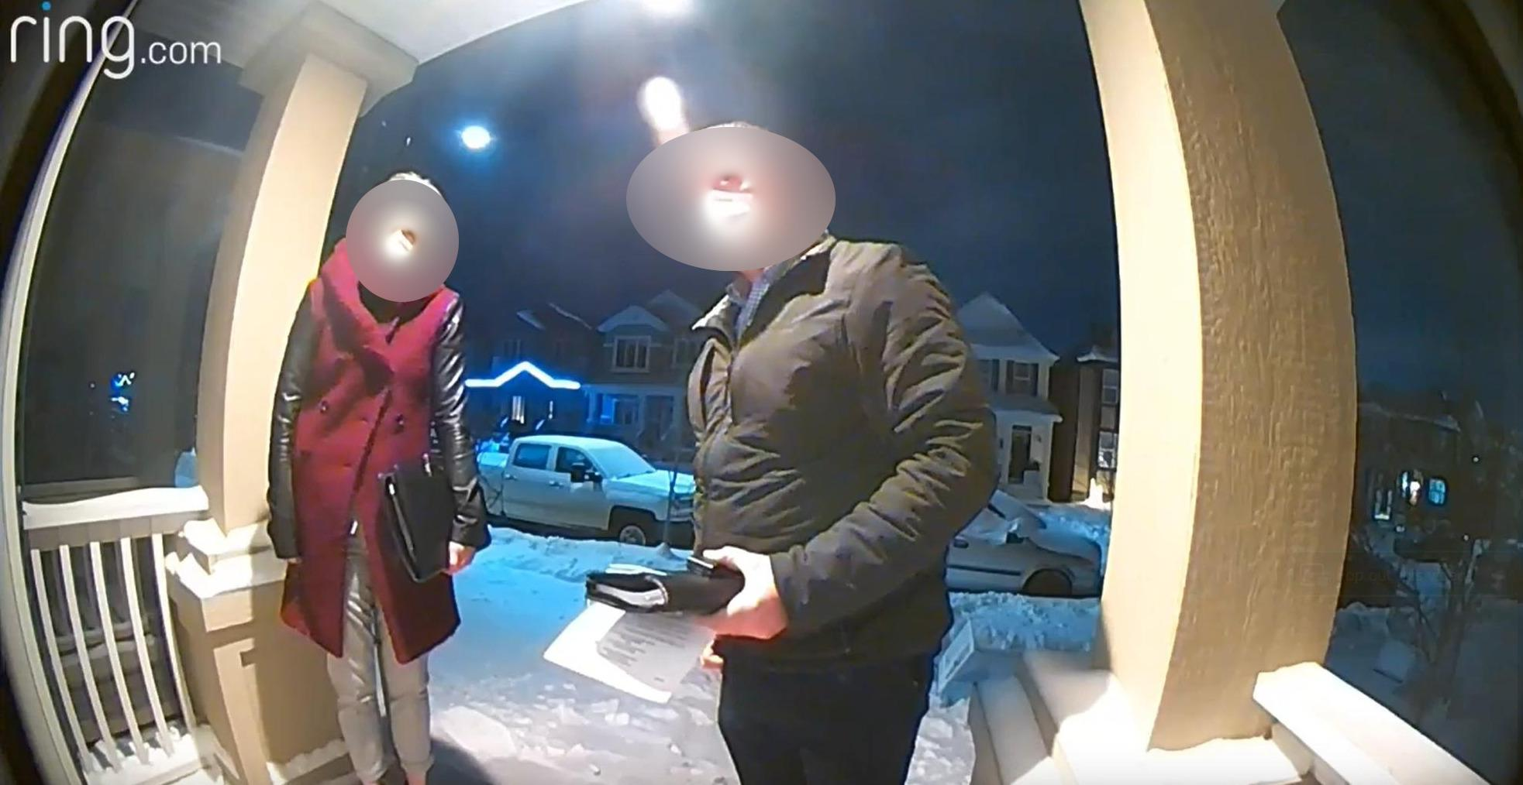
Damned If You Do
The Risks of Pointing Out The Emperor is Buck Naked
Renderman
His Holiness
Pope of the Church of Wifi
Thomas Dang
Yukon Territorial Government
Cybersecurity Architect
https://youtu.be/fL1osBUEScY

Slide 7

Secretary of the Department of Homeland Security
Alejandro Mayorkas
Basically This Fella Wants You to Work for Him https://youtu.be/MdNZC_CdHJA

Slide 8

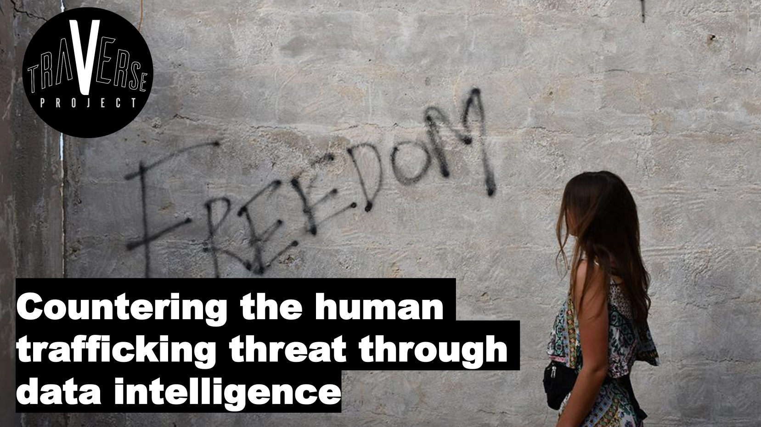
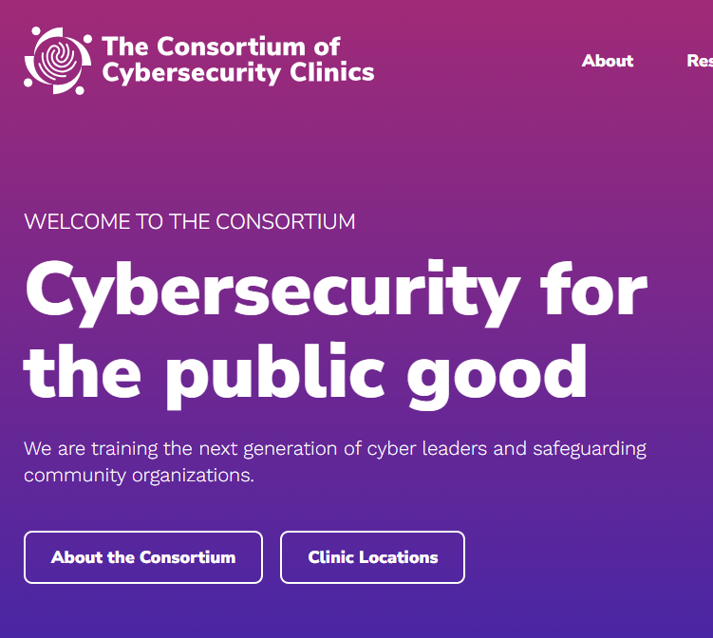
Civil Cyber Defense Use Your Resources to Defend Non-Profits as they Combat Human Trafficking and Subvert Authoritarian Regimes
Austin Shamlin Traverse Project
Co-Founder
Tiffany Rad
U.C. Berkeley
Instructor https://youtu.be/MKnOZSVq654

Slide 9
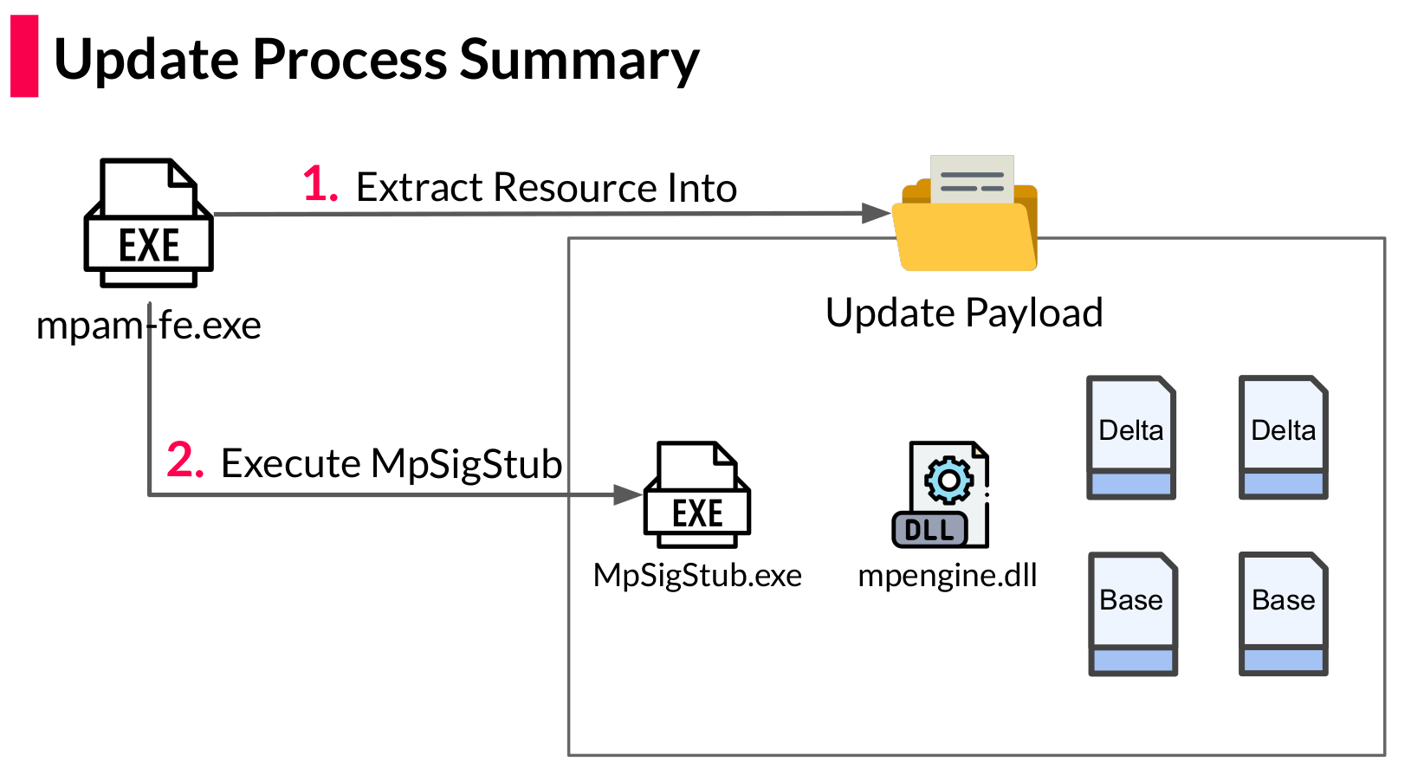
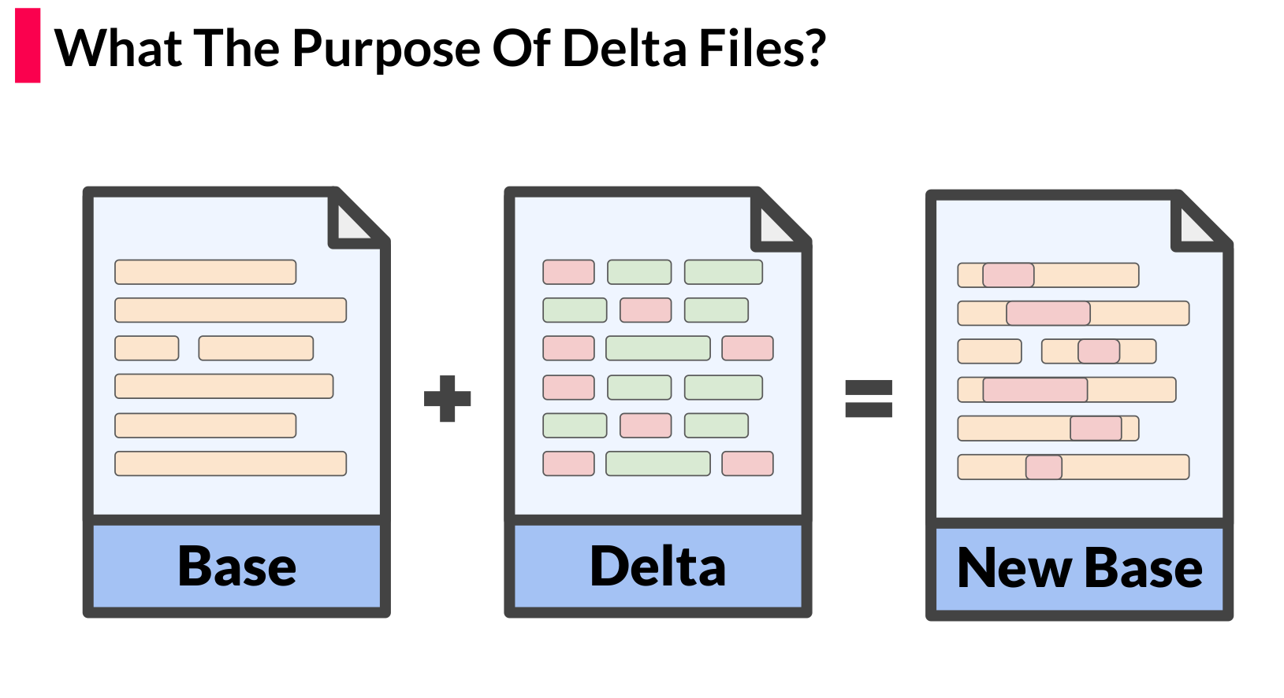
Defender-Pretender When Windows Defender Updates Become a Security Risk
Omer Attias
SafeBreach Labs
Security Researcher Tomer Bar
SafeBreach Labs
VP of Security Research
https://youtu.be/LQ7ZQXs-uC0

Slide 10
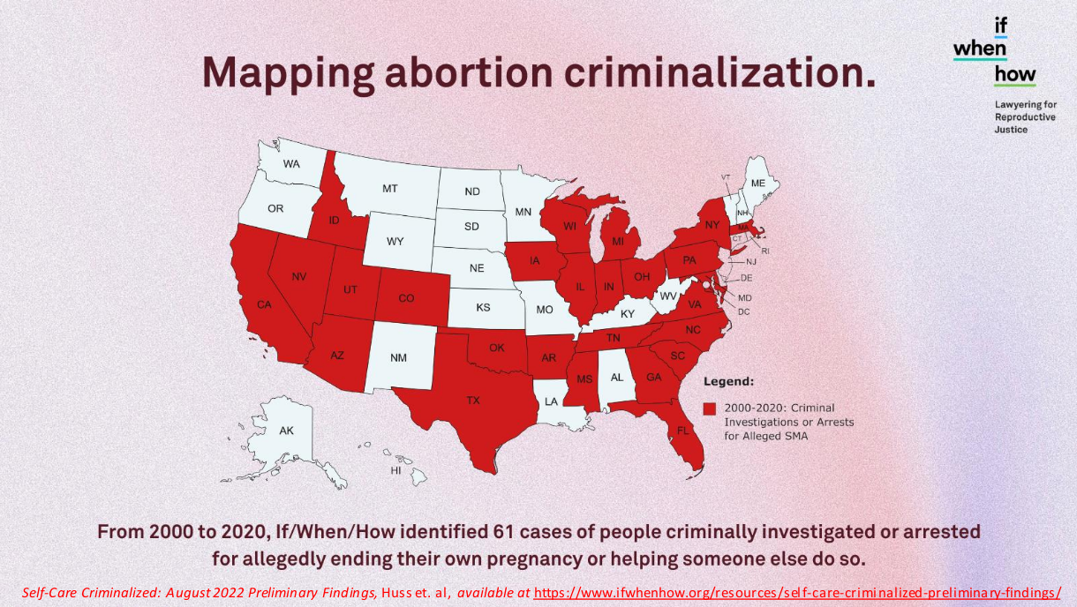
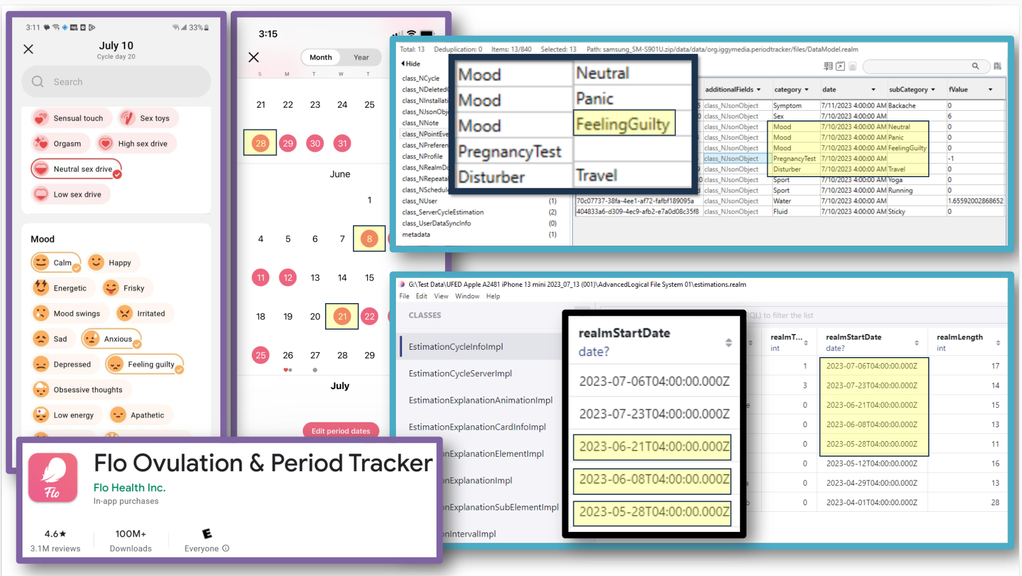
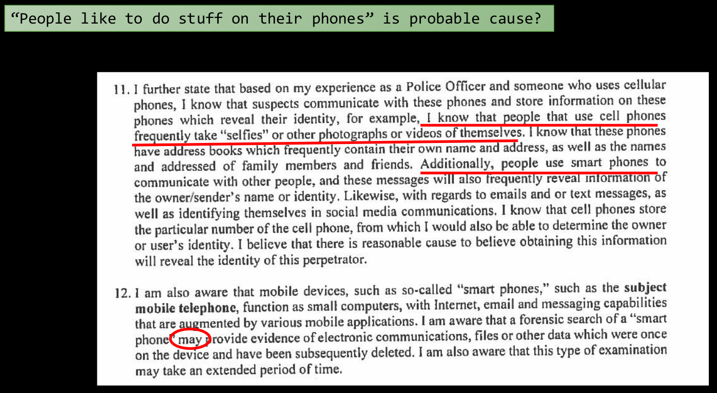
Private Until Presumed Guilty
Or How the 4th Amendment Doesn’t Protect Your Data in a Post-Dobbs World
Allison Young
The Legal Aid Society
Digital Forensics Analyst Diane Akerman
The Legal Aid Society
Digital Forensics Attorney
https://youtu.be/4FecAiofbHY

Slide 11
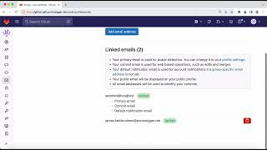
Smashing the State Machine The True Potential of Web Race Conditions
James “albinowax” Kettle
PortSwigger
Director of Research
https://portswigger.net/research/smashing-the-state-machine https://youtu.be/tKJzsaB1ZvI

Slide 12
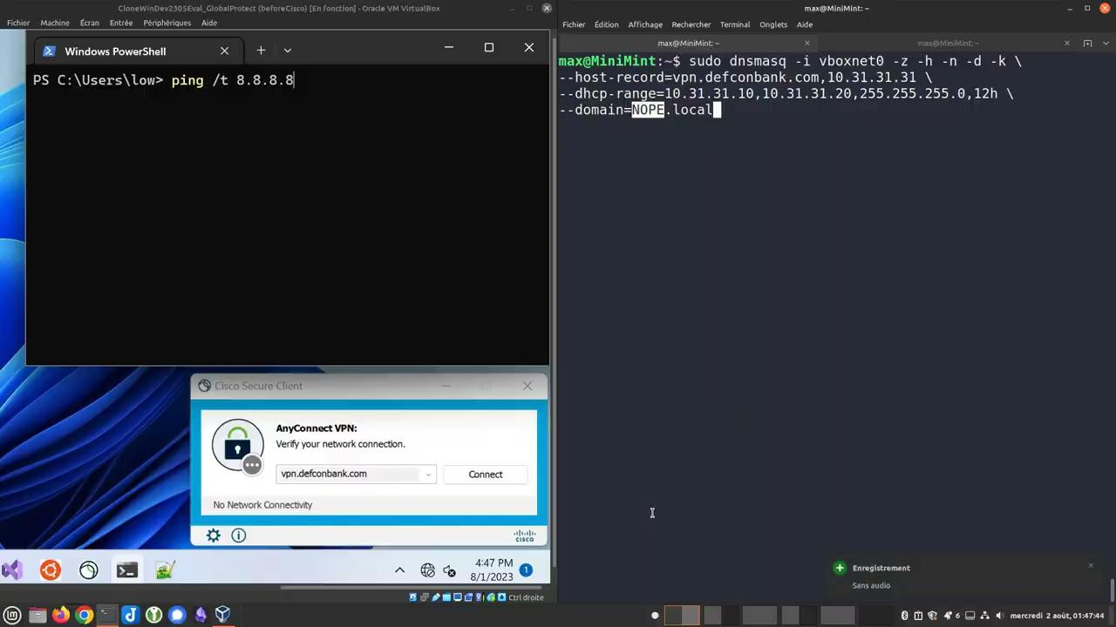
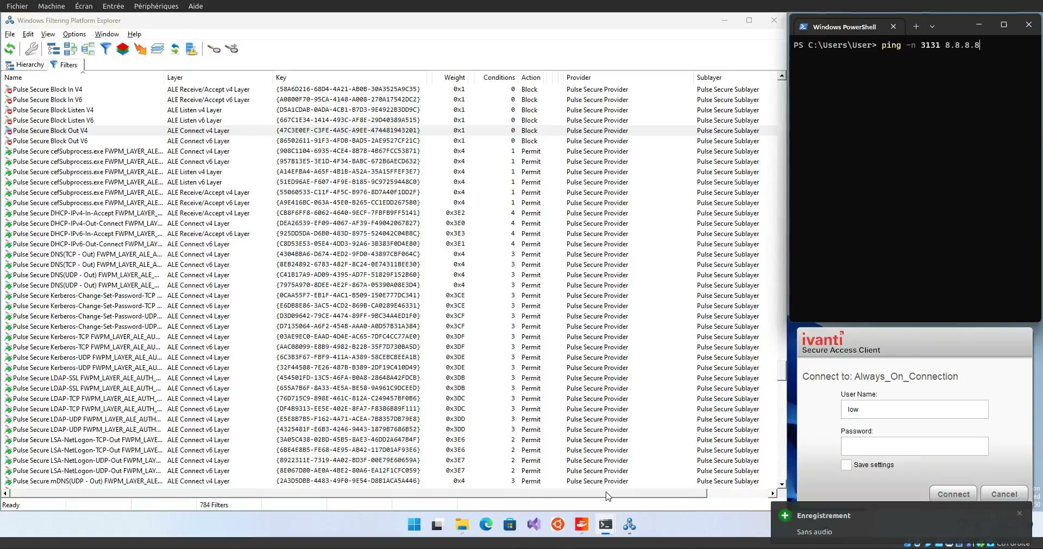
Defeating VPN Always-On
Maxime Clementz
PwC Luxembourg
Cybersecurity Senior Manager https://youtu.be/hUMKg9Xe0Zc

Slide 13
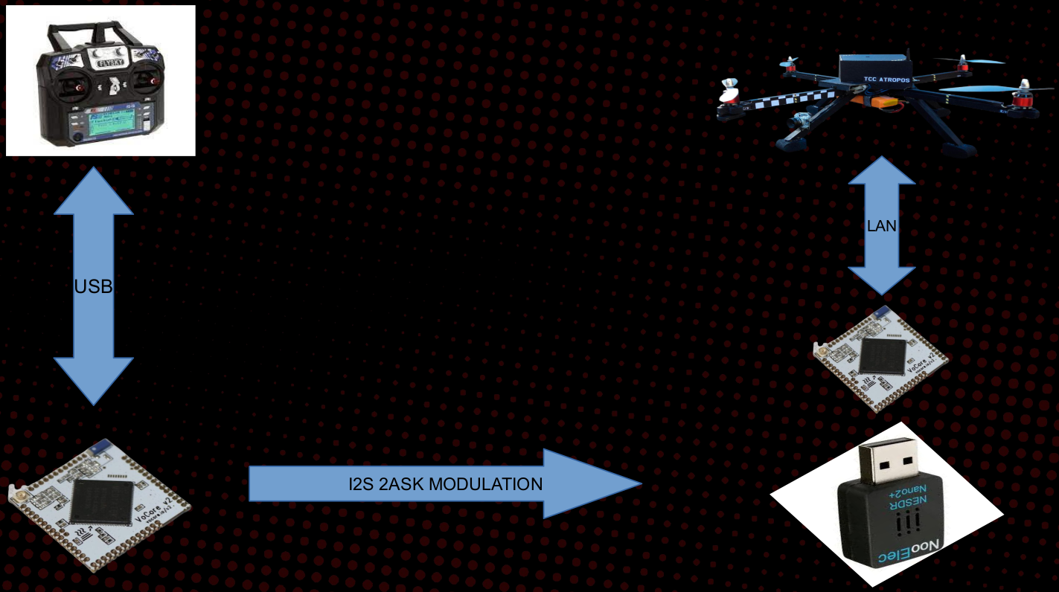
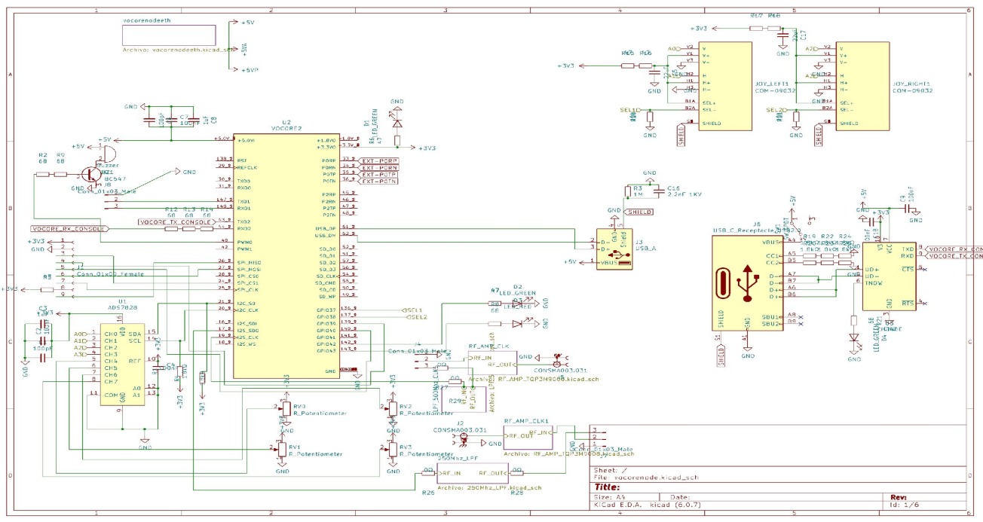
Spread Spectrum Techniques in Disposable Drones for Anti-Drone Evasion
David Melendez R&D Embedded Software Engineer
Gabriela “Gabs” Garcia
Hacker, Professor and Mentor https://youtu.be/8Ng91UY3D2M

Slide 14
Revolutionising ELF Binary Patching with Shiva A JIT Binary Patching System for Linux
Ryan “ElfMaster” O’Neill
Arcana Technologies
CTO https://youtu.be/TDMWejaucdg

Slide 15
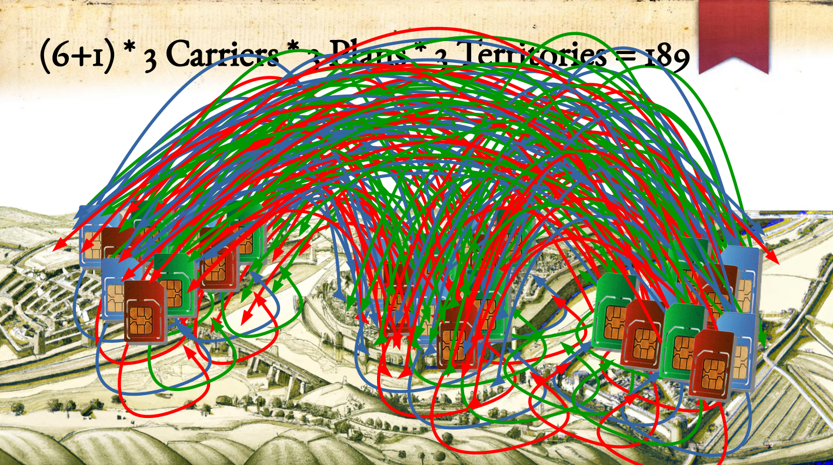
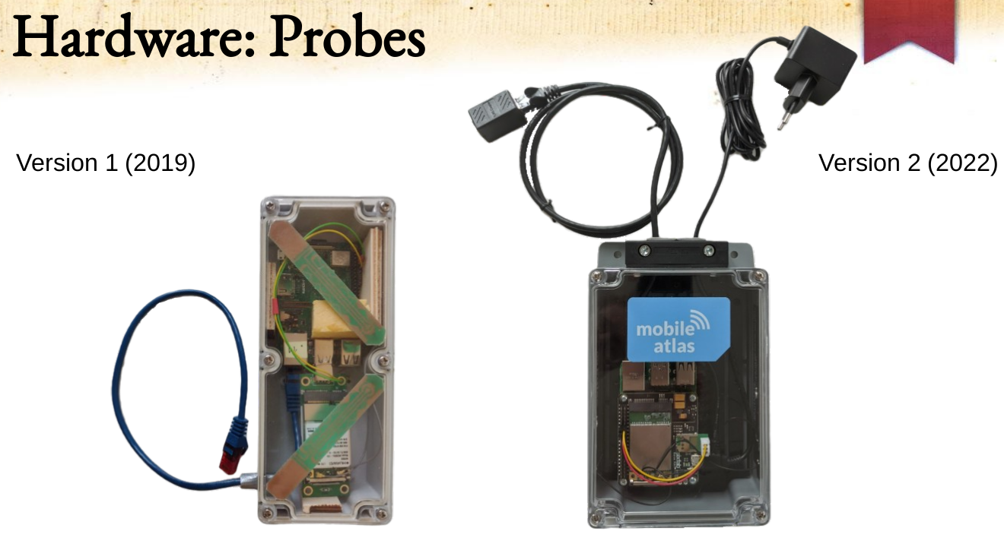



Cellular Carriers Hate This Trick Using SIM Tunneling to Travel at Light Speed
Adrian “atrox” Dabrowski
CISPA Helmholtz Center for Cybersecurity
Gabriel K. Gegenhuber
University of Vienna & SBA Research https://youtu.be/MYfeNyZIzBE

Slide 16
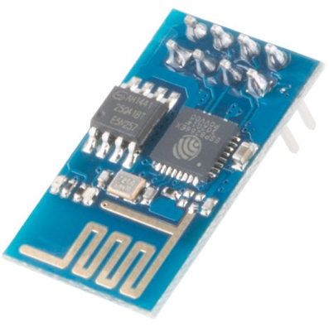
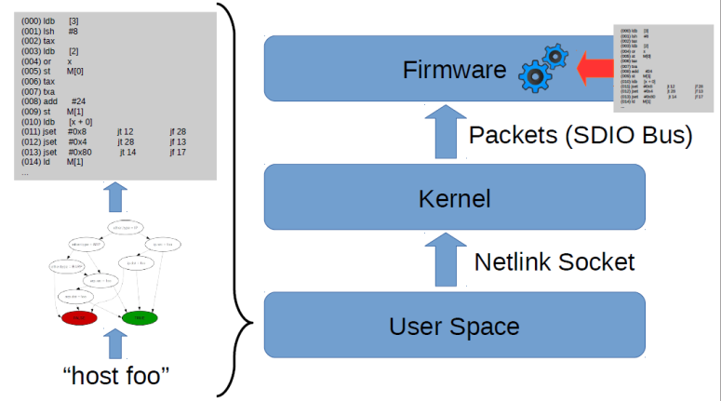
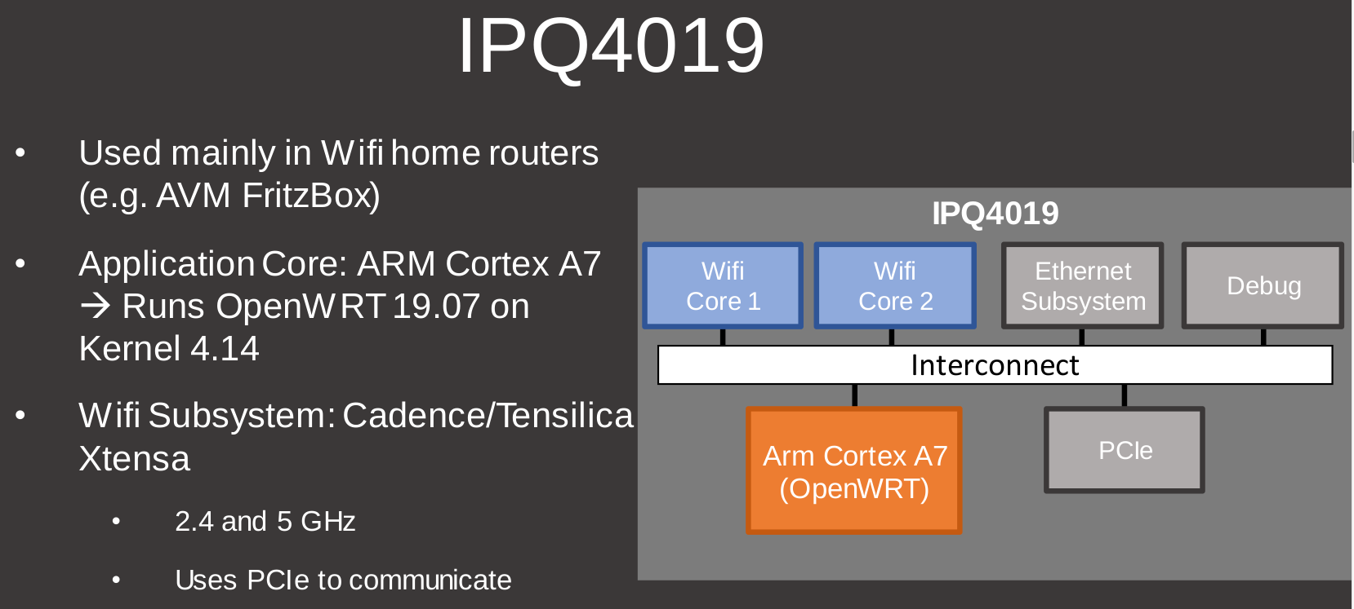
Unlocking Hidden Powers in Xtensia Based Qualcomm Wifi Chips
Daniel Wegemer
Hacker https://youtu.be/QMO2vMBcx7Y

Slide 17
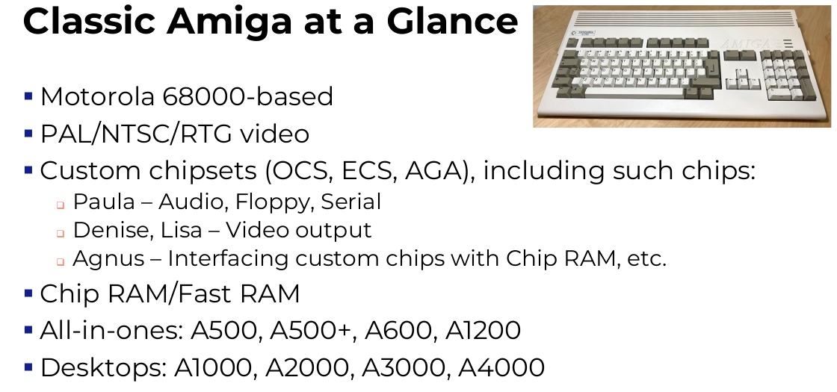
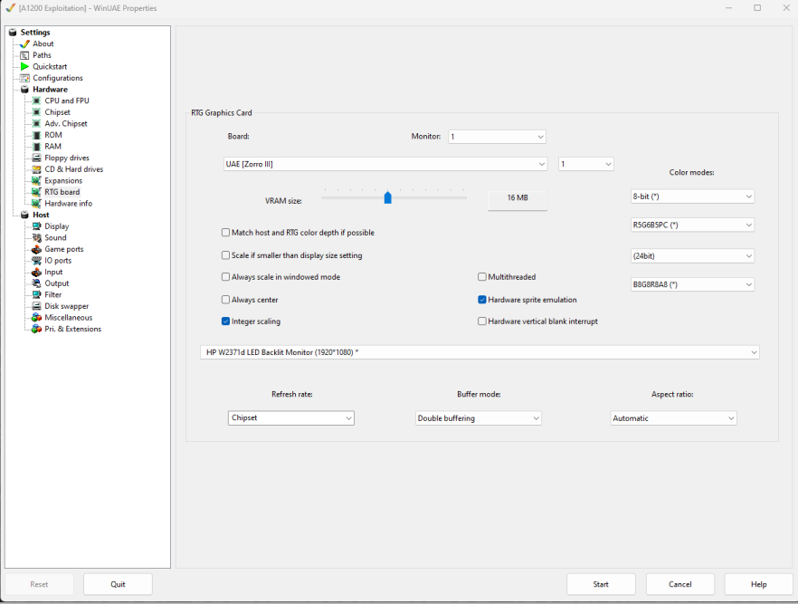
Retro Exploitation
Using Vintage Computing Platforms as a Vulnerability Research Playground and Learning Environment
Wesley McGrew
MartinFed
Senior Cyber Fellow https://youtu.be/6j4en3EbP3w

Slide 18
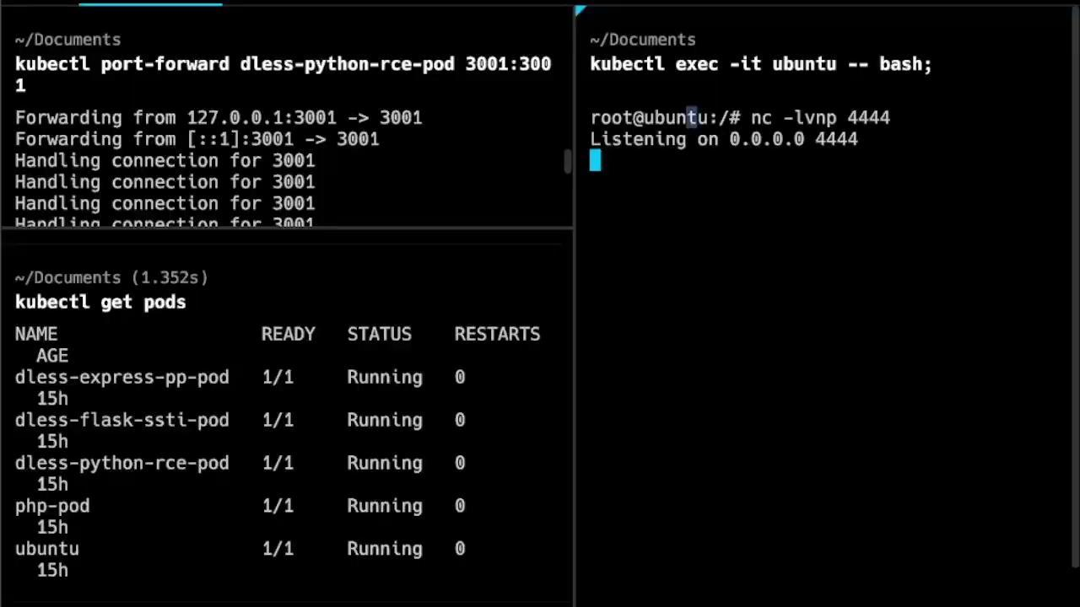
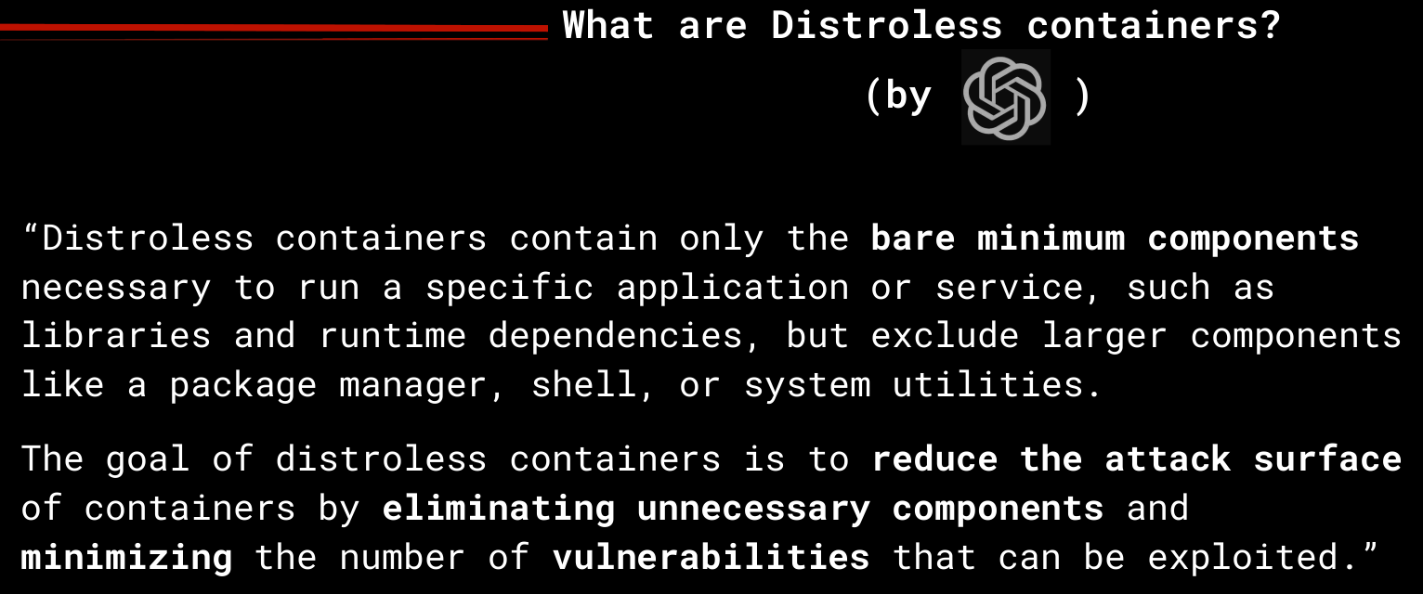
Exploring Linux Memory Manipulation for Stealth and Evasion Strategies to bypass Read-Only,
No-Exec, and Distroless Environments
Carlos Poplop
Halborn
Web, Mobile & Cloud Pentesting Team Leader
Yago Gutierrez
Mollitiam Industries
Offensive Security Researcher https://youtu.be/6j4en3EbP3w

Slide 19

All well and good, What else?

Slide 20
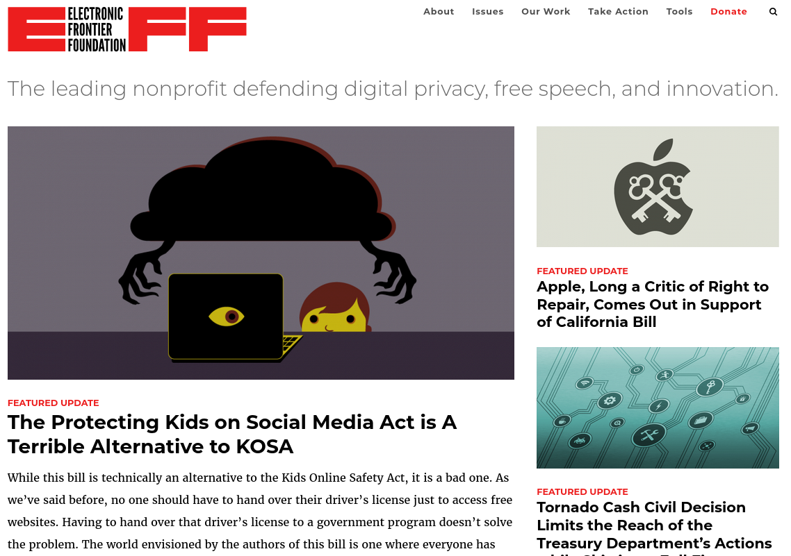
Ask the EFF
Cooper Quintin
Senior Staff Technologist
Corynne McSherry
Legal Director
Hannah Zhao
Staff Attorney
Mario Trujillo
Staff Attorney
Rory Mir
Associate Director of Community Organizing

Slide 21
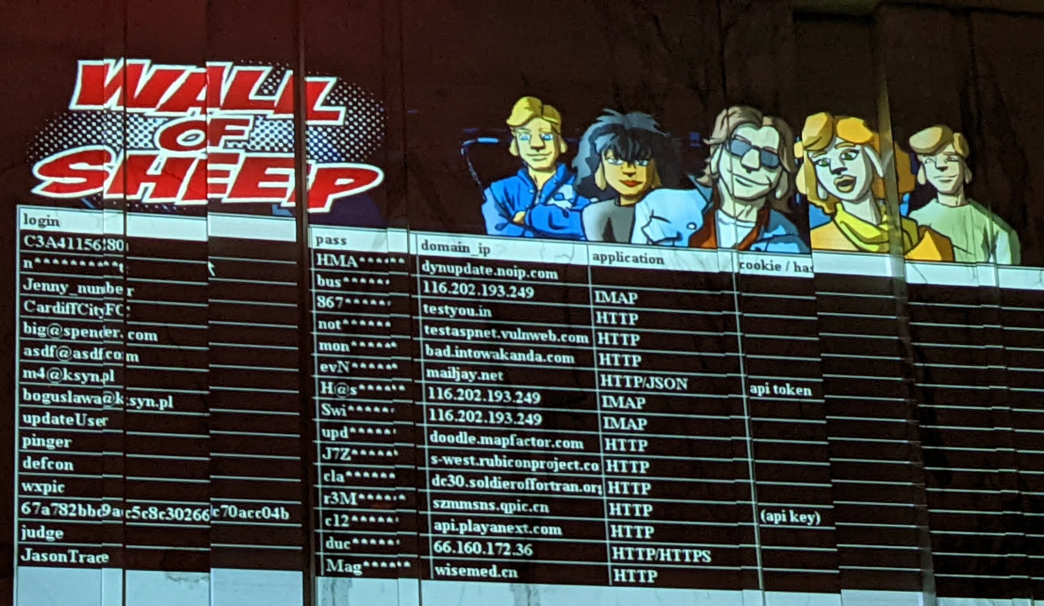
Wall of Sheep
An interactive look at what can happen when you let your guard down on public networks, the infamous Wall of Sheep passively monitors the DEF CON network looking for traffic utilizing insecure protocols. Found in the Packet Hacking village (more on villages later).

Slide 22

SODA Machine
For those worried about managing their own local resources and assets in the various CTFs and events, or those who maybe didn’t bring a laptop, they had you covered.

Slide 23
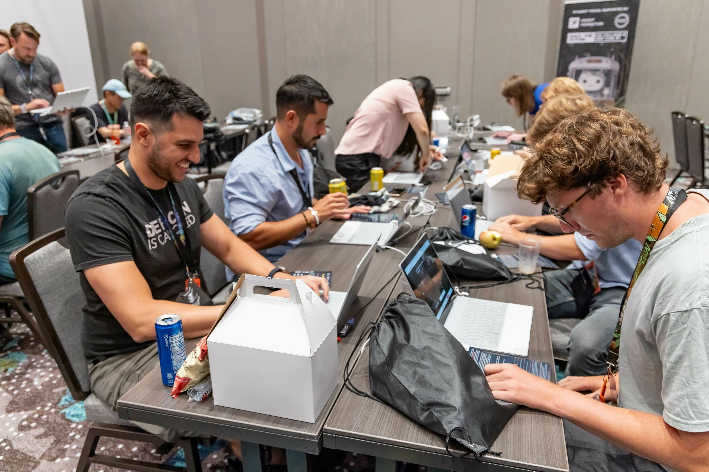



Contests and Events
(Loads of) Capture the Flag Events
Toxic BBQ
Tinfoil Hat Contest
The Lonely Hard Drive
Lockpicking Challenge
Beverage Cooling Contraption Contest
And many more…

Slide 24





Vendors
Hacker Warehouse, Hackerboxes & Hak5
Tools and Toolkits
Cigent Technology Storage Devices
Proactive data storage defence
Mar Williams
DEF CON’s resident artist
Keyport, Inc.
Lockpicking Equipment
And many many more…

Slide 25





Exhibitors
Capitol Technology University
Hack the Box
University of Advancing Technology
Ascent-Portal
Black Hills Information Security
Lacework
OpenVPN
Transportation Security Administrator

Slide 26






Villages
Aerospace Village
A.I Village
Appsec Village
Biohacking Village
Blue & Red Team Village
Car Hacking Village
Cloud Village
And many many many more…

Slide 27

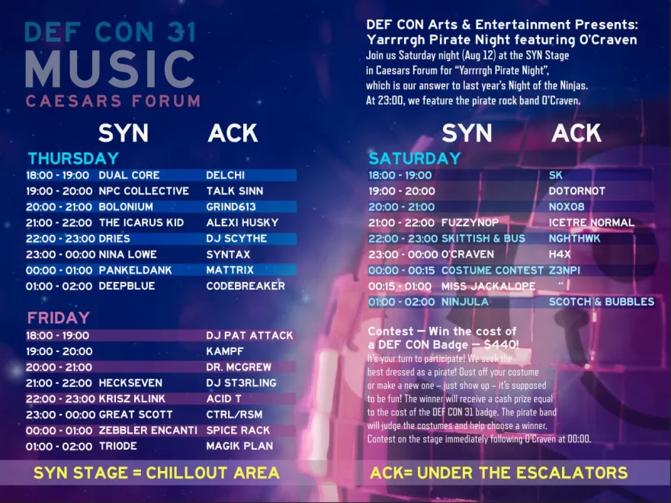
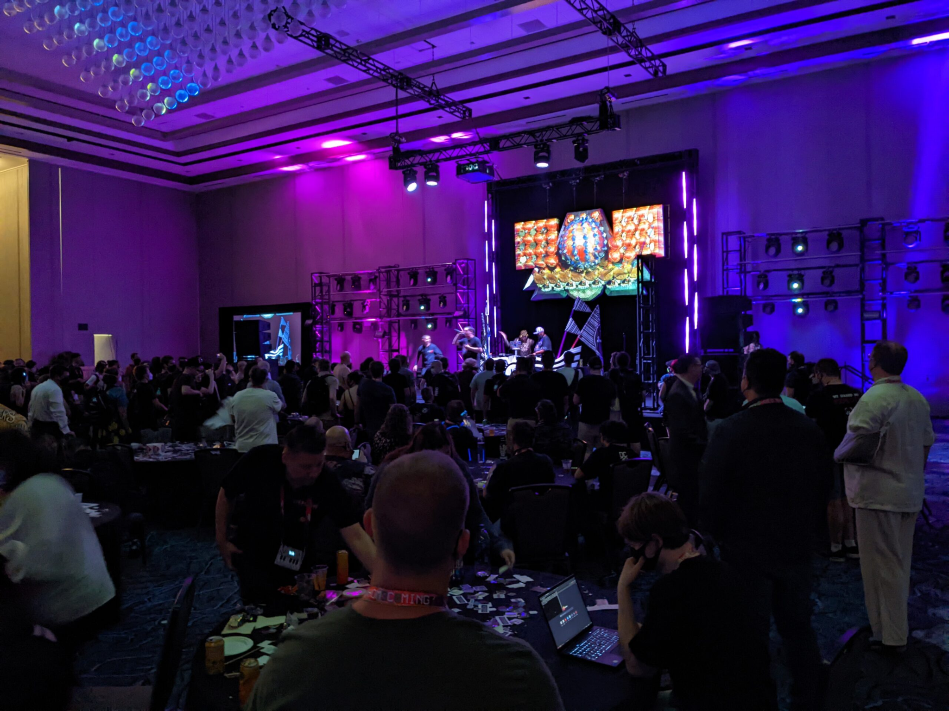
Parties & Meetups
Arcade Party
Blanketfort Con
Hacker Flairgrounds
Book Club Discussion and Exchange
Hacker Karaoke
Various Pub Crawls
BTV Pool Party
And many many many many more…

Slide 28
Any Questions?

Slide 29

Shameless Plug
I’m looking for work :)
andrewk4@pm.me
linkedin.com/in/andrew-kenneally/
github.com/andrewk10

Slide 30


